Slide 1

Production Worksheet And
Production Records
Provided by the LAUSD Food Services Division
Notes:
TELL: Welcome to the Production Worksheet and Menu Production Record training. As FS Managers, it is our job to confirm the information recorded is accurate, to be in compliant with the State and Federal regulation, and for audit purposes.

Slide 2
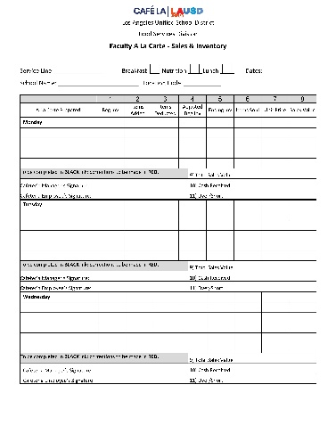
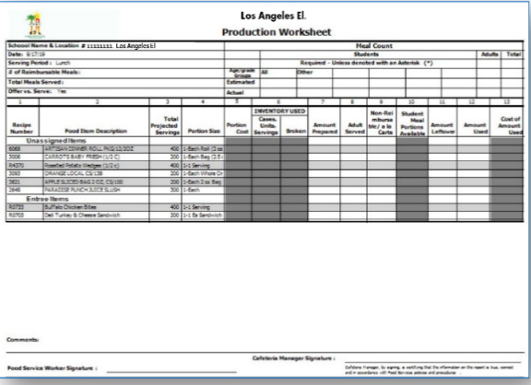
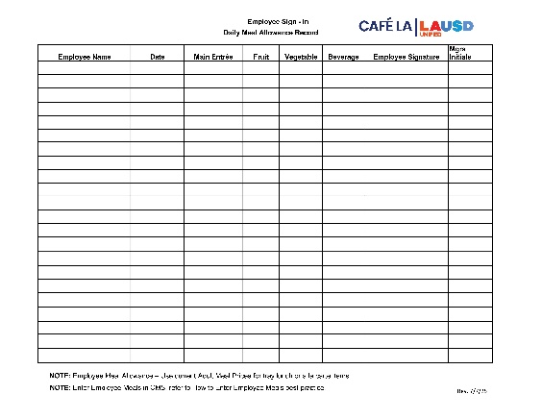
Activity Forms
This is an interactive session designed for participants to complete a simulated Production Worksheet process.
Participants will utilize the following forms:
Blank Production Worksheet
Blank Faculty A La Carte Sales and Inventory Form
Blank Daily Meal Allowance Record Form
Production Worksheet
Daily Meal Allowance Record
Faculty A La Carte Form

Slide 3
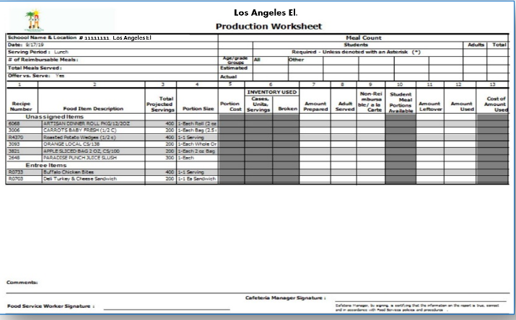
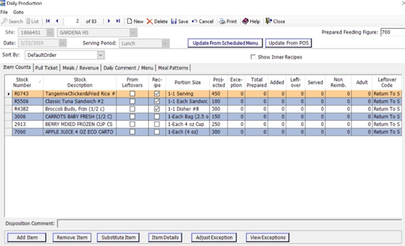
Overview
During this session, Food Services staff will acquire the skills to fill out the
Production Worksheets and Production Records.
Topics that will be covered during the session are as follows:
Completing a Production Worksheet and Production Record
How to complete a Production Record in CMS
Who's responsible for entering information
How to substitute menu items
11111111
Los Angeles El.
Production Worksheet
Production Record

Slide 4

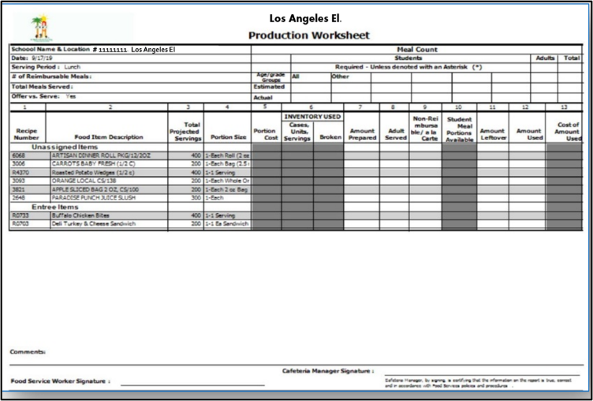
What is The Purpose of the Production Record?
Production Worksheets and Production Records are used to track meal production and ensure the school food authority is following policies and procedures for each meal service.
Production records are verified by the Federal government for accuracy to ensure site records are true representations of meal counts.
Audit Year

Slide 5



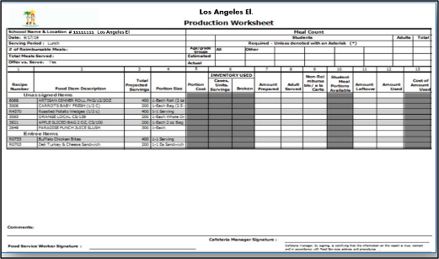
Production
Worksheet/Records Details
Production Worksheets and Production Records track the meal patterns for each meal service.
These records contain the following:
  Recipe number
  Food item descriptions
  Menu item serving size
  Age/grade nutrient standard over the school week
  Amount of reimbursable and
  non-reimbursable meals
  Food quantity prepared
  Leftovers
Amount Prepared
Amounts Tracked

Slide 6
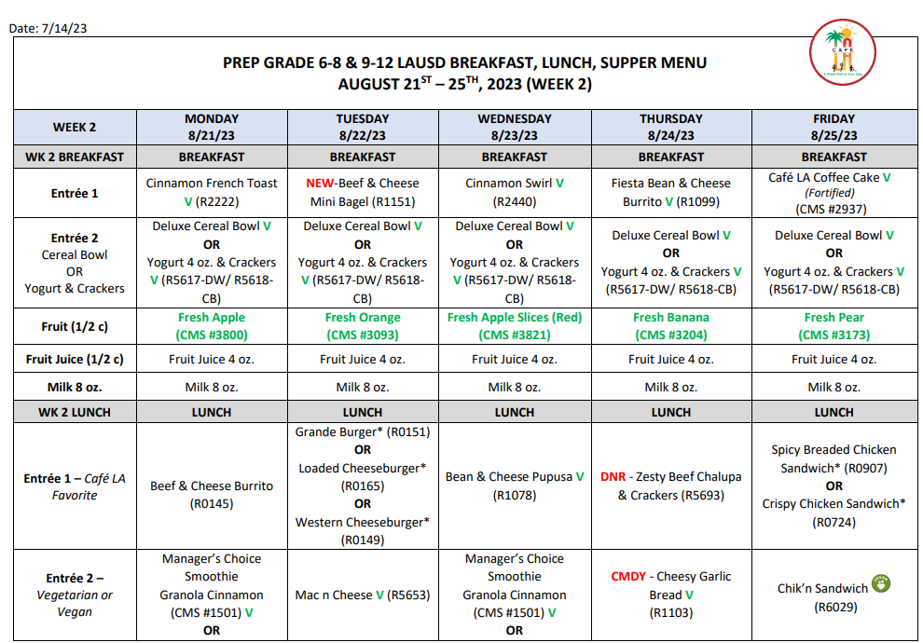
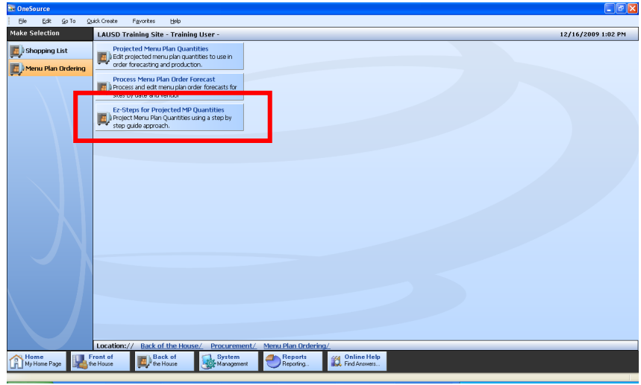
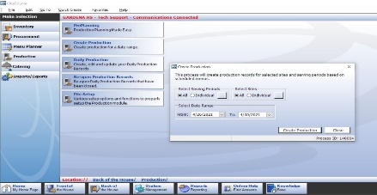
Production Timeline
Menu Plan Quantities
1
Forecasted
In Advance
2
Create Production Records With Projected Quantities
3
Projected quantities are entered for each menu item by the Food Service Manager (FSM).
One Source takes the quantities entered and forecasts the correct ingredient amounts needed.
One Source inputs the projected quantities into the Production Records for each meal service type.

Slide 7
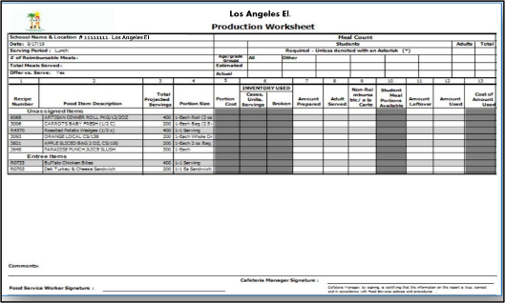

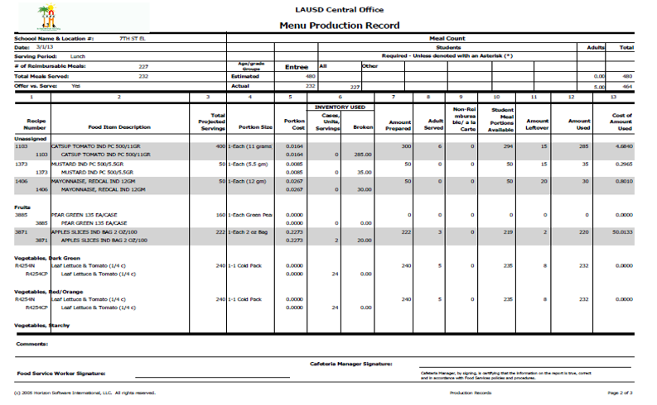
Production Timeline Cont.
Create
Production Worksheet
4
Manually Complete Production Worksheet
Input Production Worksheet Information
Into CMS
5
6
Once Production Records are created in CMS, print Production Worksheets for each upcoming service.
Manually fill out the production worksheet, documenting the meals that have been prepared, cooked, served, and leftover.
Information from the Production Worksheet is entered into CMS. These numbers are used for reimbursement.

Slide 8
PRODUCTION
WORKSHEET

Slide 9
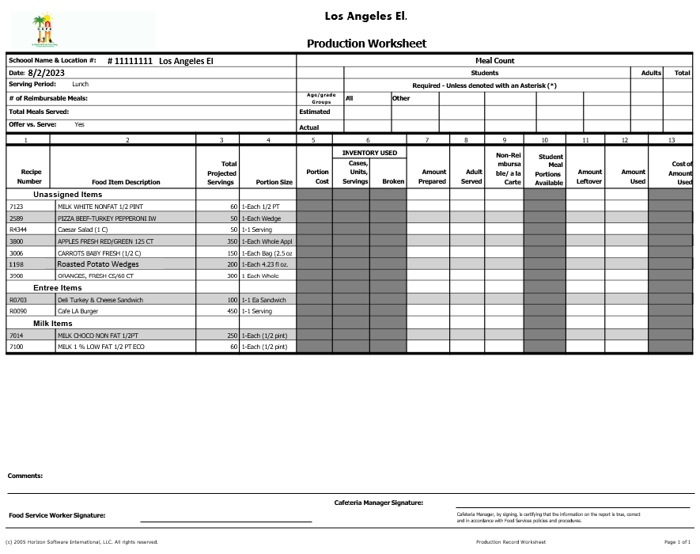
What is a Production Worksheet?
The Production Worksheet documents meals that have been prepared, cooked, served, and are leftover.
Production Worksheet information is transferred to the CMS Production Record after each meal service has been completed.
It is completed daily for each service.
8/19/2025
# 11111111 Los Angeles El

Slide 10
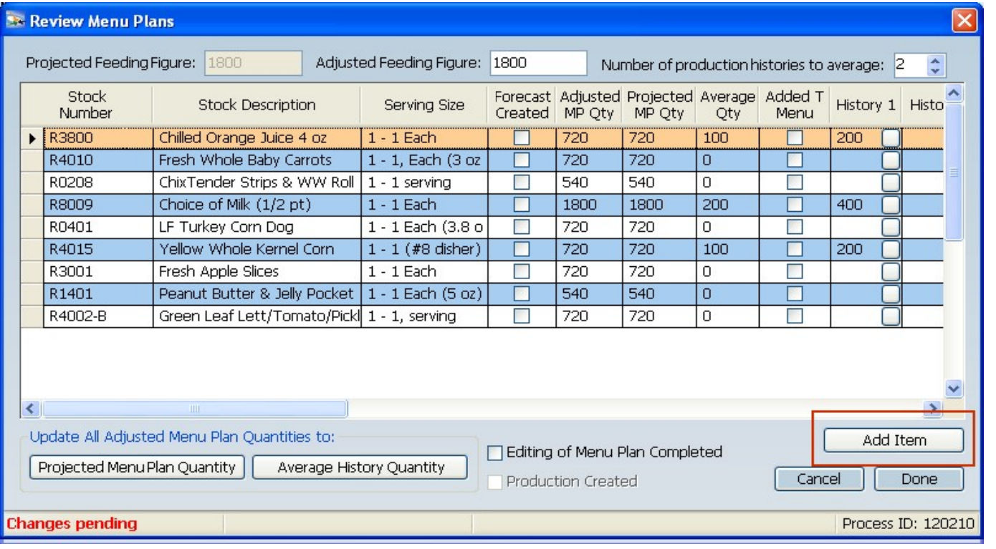
How are Production Worksheets Created?
Production Worksheets are created during the EZ-Steps process.
Based on the quantities entered during menu plans, these numbers will appear on the Production Worksheet.
These amounts are used by staff to prepare for service.
Week 1
Monday 8/18/25
Lunch
Lunch
Entrée 1
Chicken Tenders & Roll
540
Entrée 2
LF Turkey Corn Dog
720
Entrée3
Managers Choice
100
Entrée 4
Vegan
Peanut Butter
&
Jelly Pocket
540
Fruit ½ Cup
Apple Slices
720
Fruit Juice
Orange Juice 4oz
720
Vegetable
½ Cup
Whole Kernel Corn
720
Milk 8oz.
Milk 8oz.
1800

Slide 11
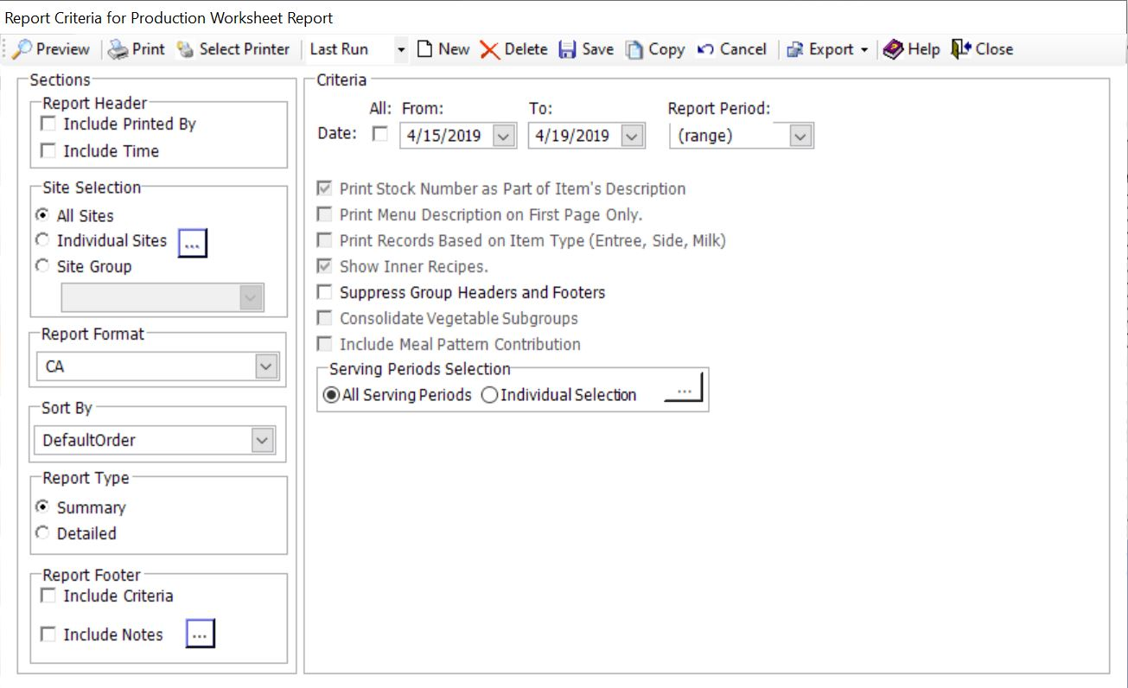
How to Print Production Worksheets
Select the criteria to view the Production Worksheet Report.
4
1
2
  Date Range
  2. Site Selection
3
  3. Format (CA)
  4. Preview

Slide 12

How To Create And Print Production Worksheets And Production Records

Slide 13
MENU
SUBSTITUTIONS

Slide 14
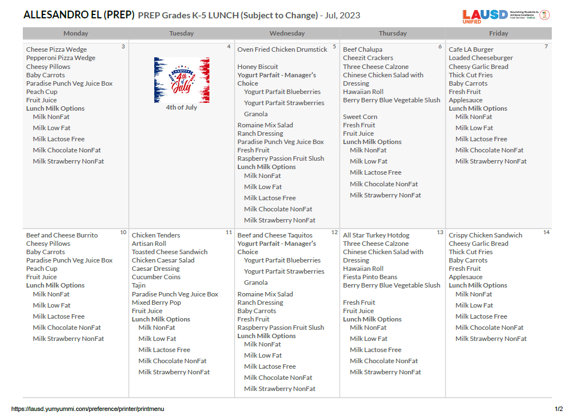
Menu Substitutions
Menus are posted at the point
of service to inform the
students and adults of the
planned menu options.
The substitution will be manually added to indicate menu changes on the posted menus.

Slide 15
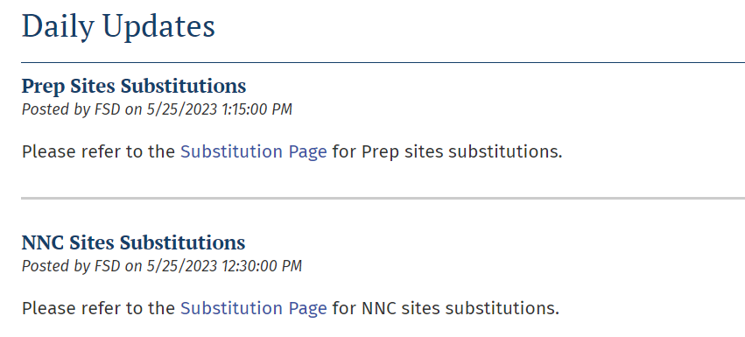
Menu Substitutions
The central office makes menu substitutions for a variety of reasons. When a substitution is made through the central office, they post it through the Daily Updates.
If necessary, shopping lists should be updated so that menu substitutions are ordered
Substitutions should be reflected on the Production Worksheet

Slide 16




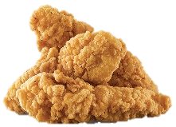

When to Make Substitutions
Cafeteria managers can make menu substitutions for the following reasons:
Substitutions because of missed orders or deliveries.
To use up excess product sitting on shelves or near expiration.
When making substitutions, refer to the Menu Contribution List to ensure the meal pattern requirements are met.

Slide 17
Cross out the item to be substituted and write in the item to be served.
Los Angeles El. (PREP)
Crispy Chicken Filet Sandwich
Note: Substitutions should be made manually with a red pen.

Slide 18
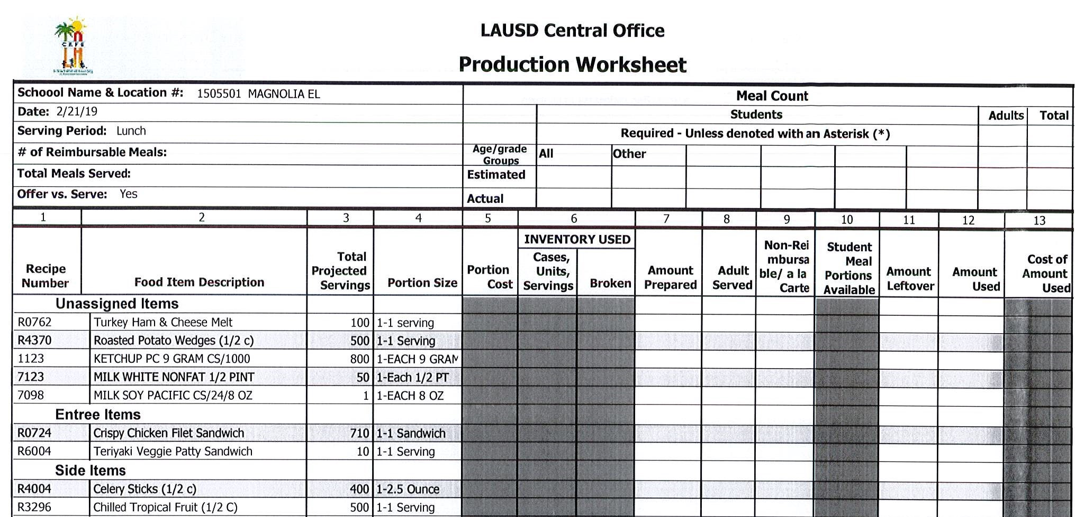



Menu Substitutions
Update the Production Worksheet to reflect the substituted items that will be prepared for service.
Put a line through the item that was not available. Manually write in the substituted food item.
# 11111111 Los Angeles El
8/19/2025
They sent us Chicken Fillet Patties instead of Mini Corn dogs.
Chicken Filet Sandwich
Mini Chicken Corn Dogs
3/17/23
3/17/23
3/17/23
3/17/23
3/17/23
3/17/23
3/17/23
3/17/23
3/17/23
3/17/23

Slide 19
PRODUCTION
WORKSHEET
COLUMNS

Slide 20


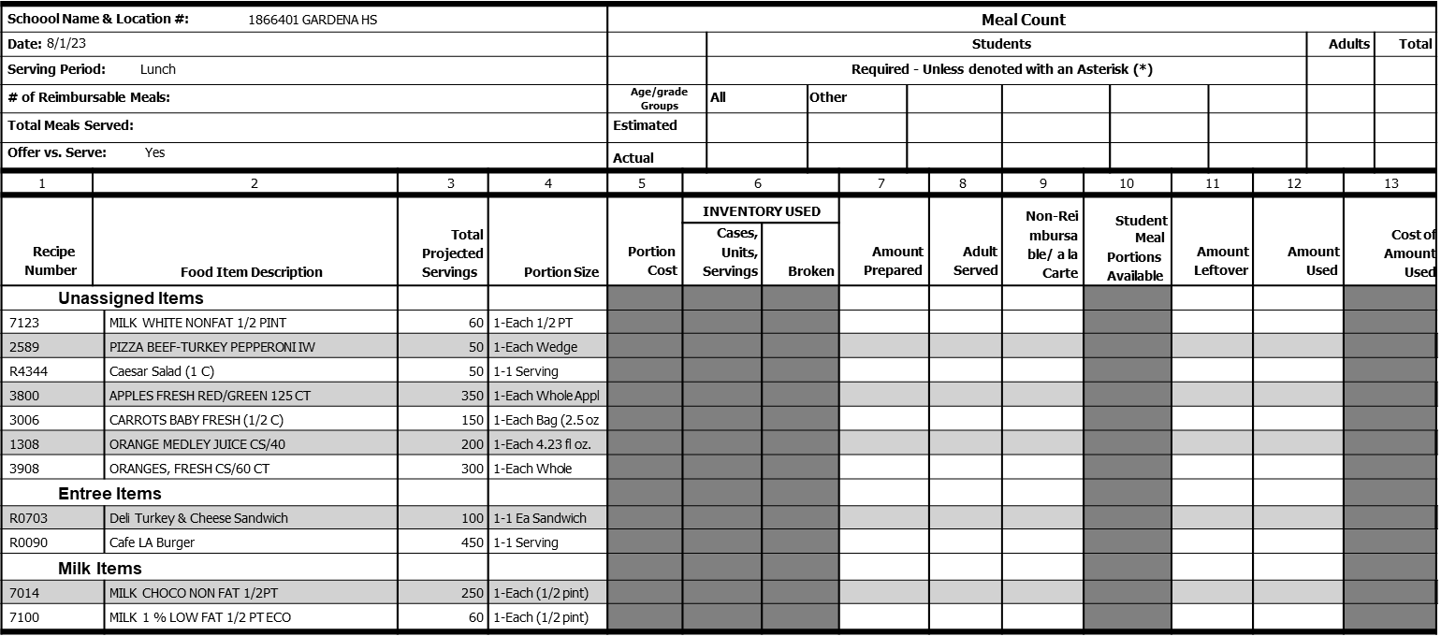

# 11111111 Los Angeles El
8/18/2025
Production
Worksheet
Activity
Comments:
Food Service Worker Signature:
Cafeteria Manager Signature:
Cafeteria Manager, by signing, is certifying that the information on the report is true, correct and in accordance with Food Services policies and procedures.
(c) 2005 Horizon Software International, LLC. All rights reserved.
Production Record Worksheet
Page 1 of 1

Slide 21









# 11111111 Los Angeles El
8/19/2025
1198
ROASTED POTATO WEDGES
Comments:
Food Service Worker Signature:
Cafeteria Manager Signature:
Cafeteria Manager, by signing, is certifying that the information on the report is true, correct and in accordance with Food Services policies and procedures.
(c) 2005 Horizon Software International, LLC. All rights reserved.
Production Record Worksheet
Page 1 of 1

Slide 22


1
Columns 1 Is the recipe and stock number column.
Its important to have all stock and recipe numbers on the production worksheet. This includes any items added onto the production as well.
Recipes
7123
2589
R4344
3800
3006
1198
3908
R0090
Column
Comments:
Food Service Worker Signature:
Cafeteria Manager Signature:
Cafeteria Manager, by signing, is certifying that the information on the report is true, correct and in accordance with Food Services policies and procedures.
(c) 2005 Horizon Software International, LLC. All rights reserved.
Production Record Worksheet
Page 1 of 1

Slide 23


2
3
Total Projected Servings
Columns 2 Is what food items you will prepare for the days service.
Column 3 is the total amount you need to prepare for each item.
Food Item Description
Milk White Non Fat ½ Pint
60
Pizza Beef-Turkey IW
50
Caesar Salad
50
Apples Fresh Red/Green
350
Carrots Baby Fresh (1/2C)
150
Roasted Potato Wedges
200
Oranges Fresh
300
Column
Column
450
Café LA Burger
Comments:
Food Service Worker Signature:
Cafeteria Manager Signature:
Cafeteria Manager, by signing, is certifying that the information on the report is true, correct and in accordance with Food Services policies and procedures.
(c) 2005 Horizon Software International, LLC. All rights reserved.
Production Record Worksheet
Page 1 of 1

Slide 24


7
11
Columns 7 is where you will enter amount prepared.
Column 11 is for leftover amounts after service is complete.
Amount
Prepared
Amount
Leftover
Column
Column
Comments:
Food Service Worker Signature:
Cafeteria Manager Signature:
Cafeteria Manager, by signing, is certifying that the information on the report is true, correct and in accordance with Food Services policies and procedures.
(c) 2005 Horizon Software International, LLC. All rights reserved.
Production Record Worksheet
Page 1 of 1

Slide 25
Who is Responsible for Completing the Production Worksheets?
    Food Service Managers (FSM)
    Senior Food Service Workers (Sr. FSW)
    Food Service Workers (FSW)
    Substitute Food Service Workers (Sub FSW)
    All the Above
All cafeteria personnel must thoroughly understand and be competent in filling out the Production Worksheets.

Slide 26






Assign Staff to Fill-In
Production Worksheet
Instruct staff to write amount prepared and leftovers on the Production Record Worksheet.
Do not use “piece of paper” or verbal methods.
15 - blue
10 - choco
35 - 1%
No Leftovers
8 burrito
1cs Carrot

Slide 27
# 11111111 Los Angeles El
8/18/2025
Production
Worksheet
Activity
Comments:
Food Service Worker Signature:
Cafeteria Manager Signature:
Cafeteria Manager, by signing, is certifying that the information on the report is true, correct and in accordance with Food Services policies and procedures.
(c) 2005 Horizon Software International, LLC. All rights reserved.
Production Record Worksheet
Page 1 of 1

Slide 28


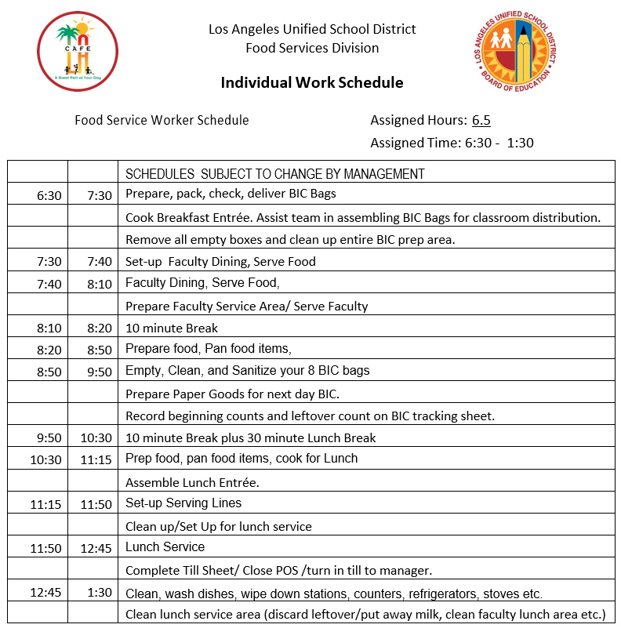


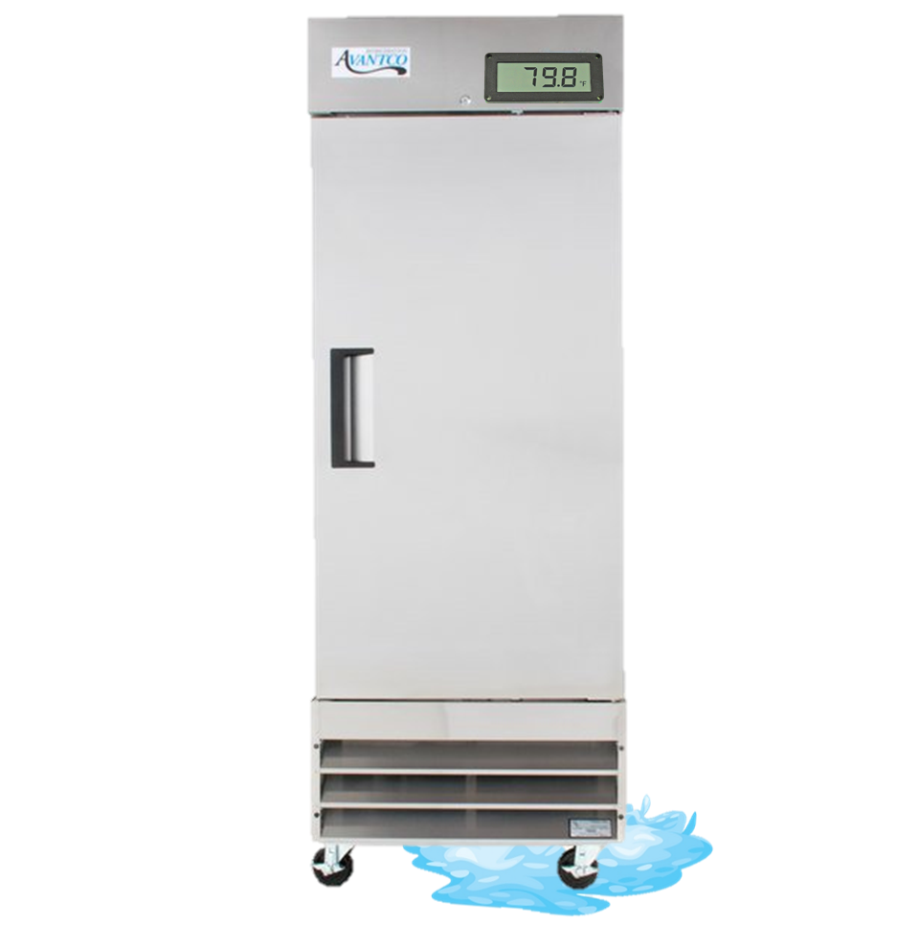







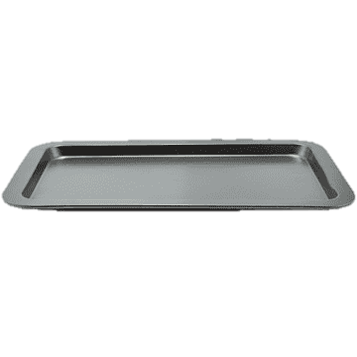



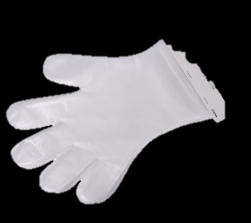

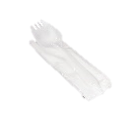







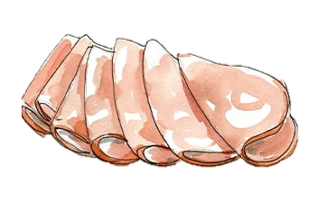
I’ve finished panning 100 sandwiches now I will enter the amount prepared using a pencil in
Column 7
Now let’s prep the Deli Turkey & Cheese Sandwiches and input the prepared amounts in Column 7

Slide 29








I’ve finished Panning 50 pizzas now I will enter the Amount prepared in
Column 7
Now let’s pan the pizza and input the prepared amounts in Column 7

Slide 30












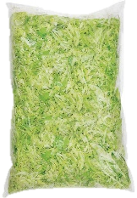
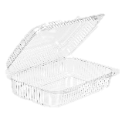
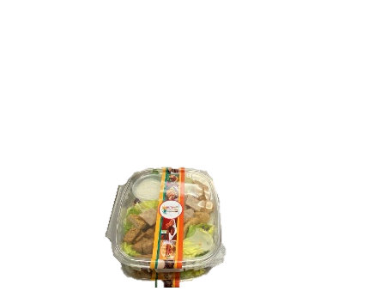
Now let’s prepare the Caesar Salads for the day and input the prepared amounts in Column 7
I’ve prepared 50 Caesar Salads now I will enter the Amount prepared in
Column 7

Slide 31






Now let’s prep the Café LA Burgers and input the prepared amounts in Column 7
I’ve finished panning 450 Café LA Burgers.

Slide 32



I’ve finished Panning 200 Potato Wedges now I will enter the Amount prepared in
Column 7
Now let’s pan the Potato wedges and input the prepared amounts in Column 7

Slide 33





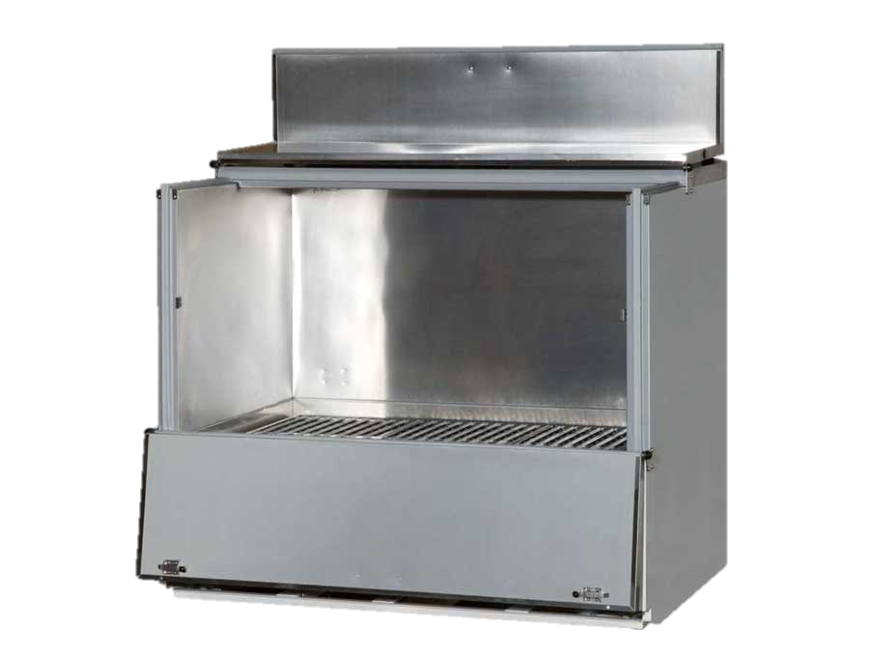
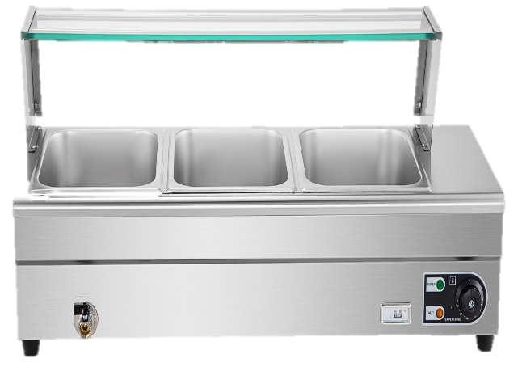



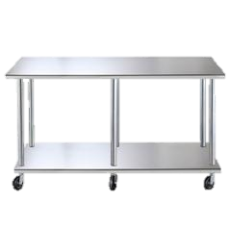
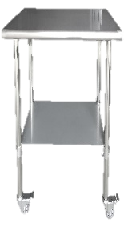





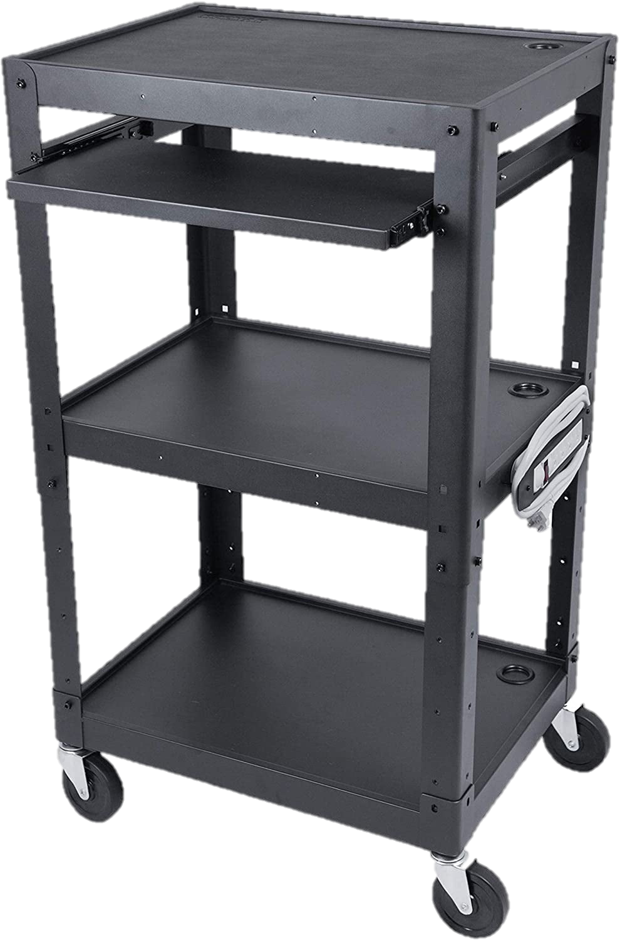

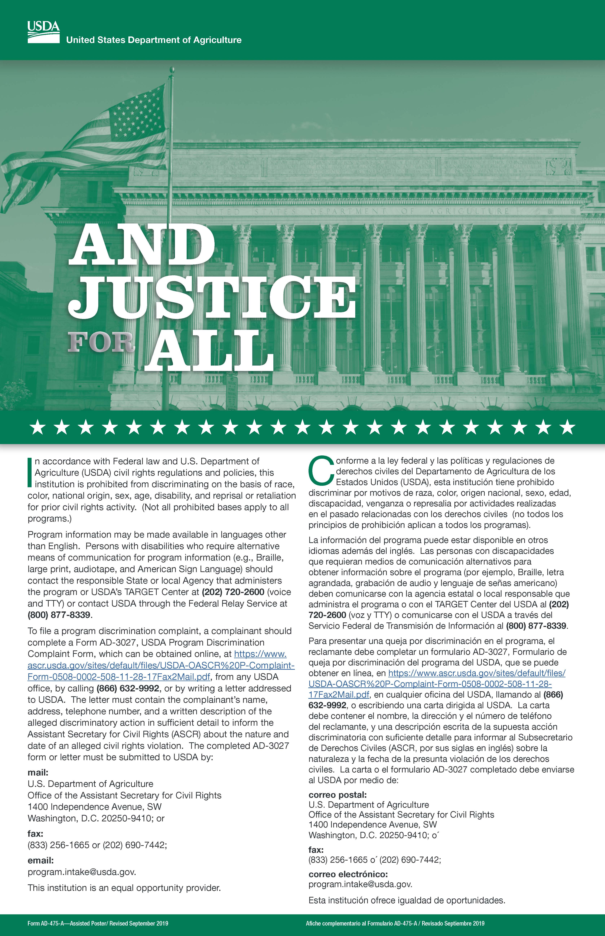


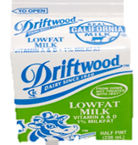
Elementary
Now let’s set up the scramble area for lunch and input the prepared amounts in Column 7

Slide 34





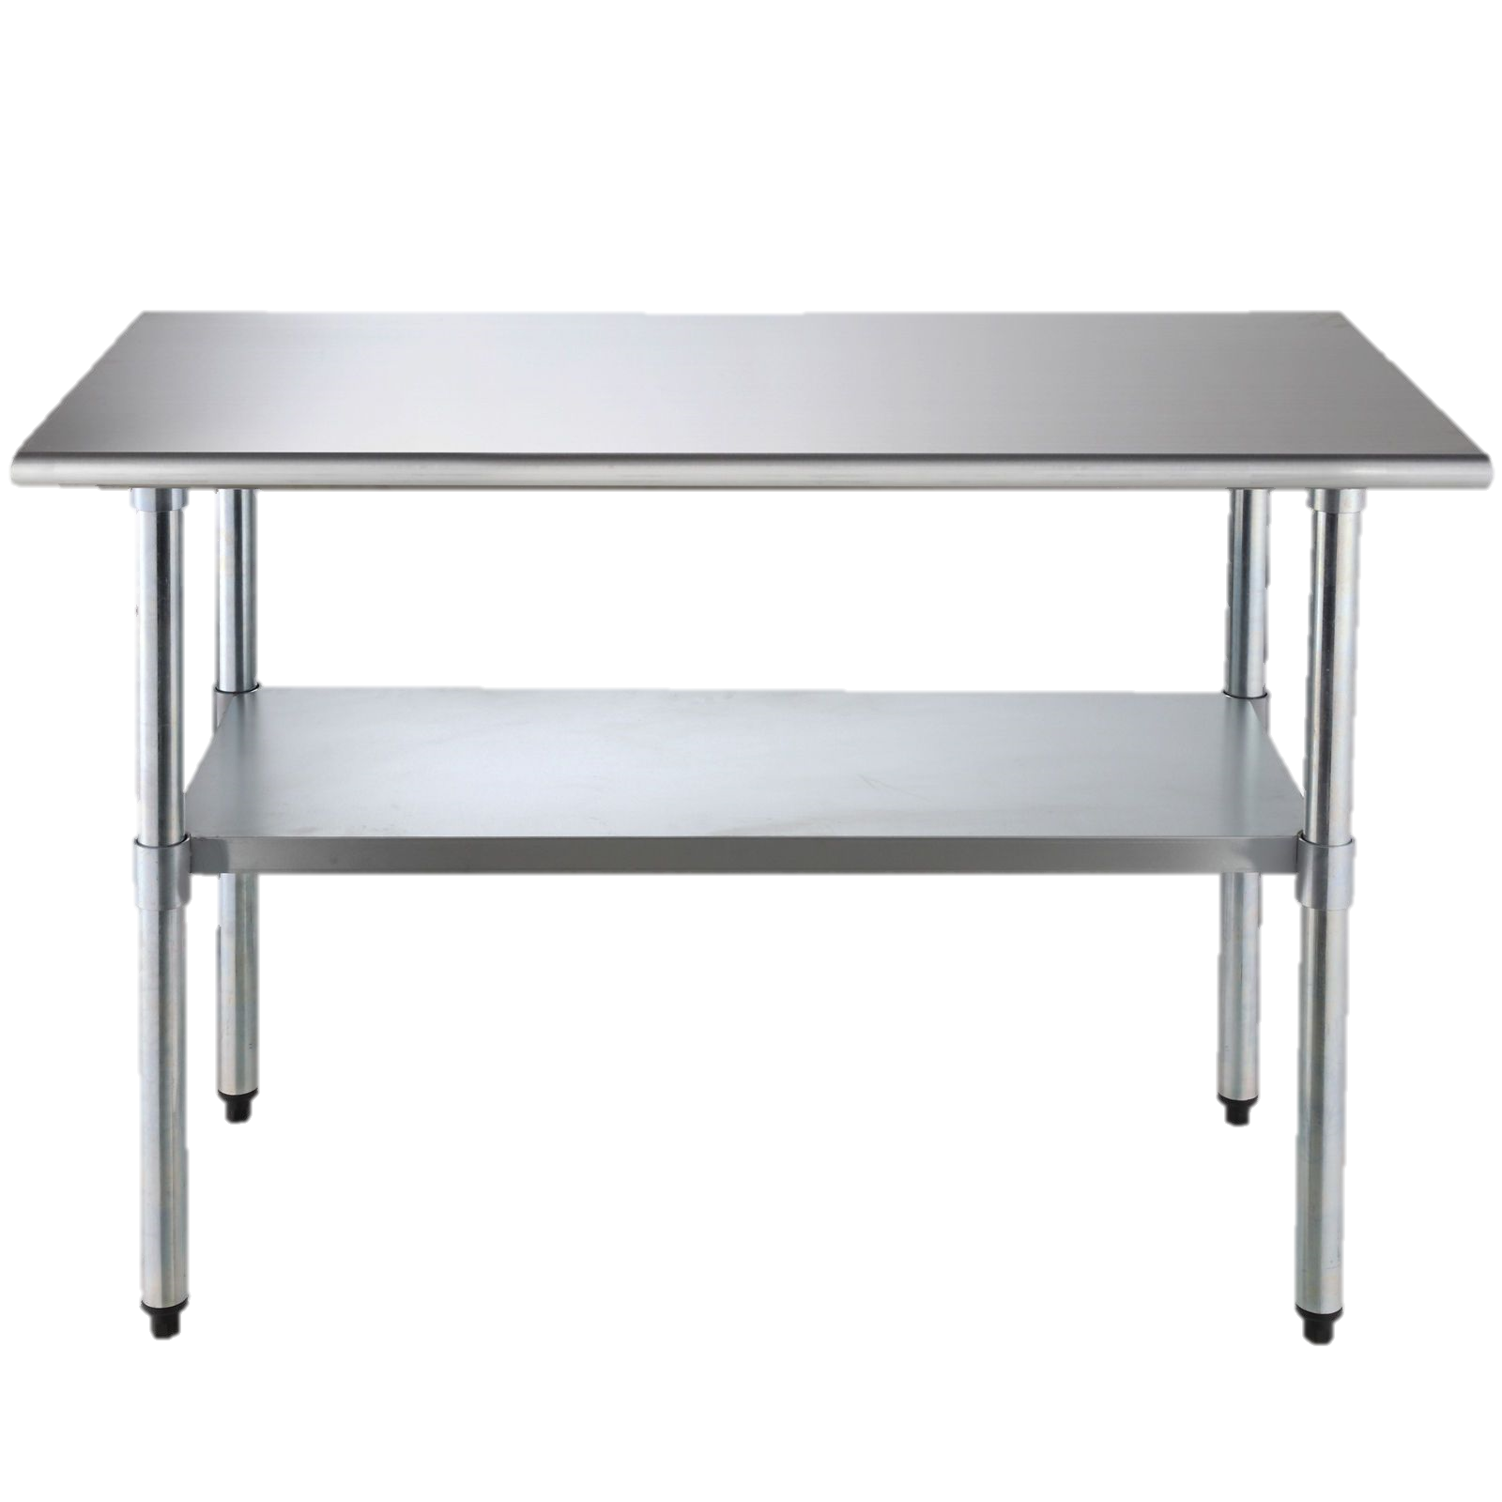



Elementary
Time to add the fruits and vegetables based on the quantities in Column 3 Total Projected Servings.
350
300
150

Slide 35
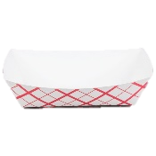





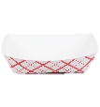

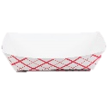
Elementary
Setup your serving line with hot items

Slide 36
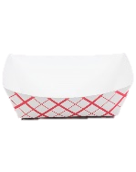




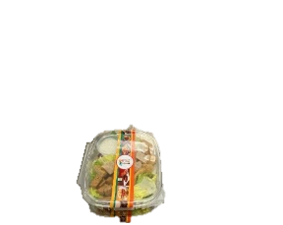




Elementary
Let's setup our cold items.

Slide 37
Following Column 3 Total Projected Servings, fill the beverage cooler with milk for lunch.
Chocolate Milk
250
1 % Low Fat Milk
60
Non-Fat Milk
60

Slide 38

Los Angeles El.
GARDENA HS
Production Worksheet
# 11111111 Los Angeles El
Schoool Name & Location #: 1866401 GARDENA HS |  |  |  |  | Meal Count
Date: 8/1/23 |  |  |  |  |  |  | Students |  |  |  |  |  |  |  |  |  |  |  | Adults |  | Total
Serving Period: Lunch |  |  |  |  |  |  | Required - Unless denoted with an Asterisk (*)
# of Reimbursable Meals: |  |  |  |  | Age/grade Groups |  | All |  | Other
Total Meals Served: |  |  |  |  | Estimated
Offer vs. Serve: Yes |  |  |  |  | Actual
1 | 2 |  | 3 | 4 | 5 | 6 |  |  |  | 7 |  | 8 | 9 | 10 |  | 11 |  | 12 |  | 13
Recipe Number | Food Item Description |  | Total Projected Servings | Portion Size | Portion Cost | INVENTORY USED |  |  |  | Amount Prepared |  | Adult Served | Non-Rei mbursa ble/ a la Carte | Student Meal Portions Available |  | Amount Leftover |  | Amount Used |  | Cost of Amount Used
 |  |  |  |  |  | Cases, Units, Servings |  | Broken
Unassigned Items
7123 |  | MILK WHITE NONFAT 1/2 PINT | 60 | 1-Each 1/2 PT
2589 |  | PIZZA BEEF-TURKEY PEPPERONI IW | 50 | 1-Each Wedge
R4344 |  | Caesar Salad (1 C) | 50 | 1-1 Serving
3800 |  | APPLES FRESH RED/GREEN 125 CT | 350 | 1-Each Whole Appl
3006 |  | CARROTS BABY FRESH (1/2 C) | 150 | 1-Each Bag (2.5 oz
1308 |  | ORANGE MEDLEY JUICE CS/40 | 200 | 1-Each 4.23 fl oz.
3908 |  | ORANGES, FRESH CS/60 CT | 300 | 1-Each Whole
Entree Items
R0703 |  | Deli Turkey & Cheese Sandwich | 100 | 1-1 Ea Sandwich
R0090 |  | Cafe LA Burger | 450 | 1-1 Serving
Milk Items
7014 |  | MILK CHOCO NON FAT 1/2PT | 250 | 1-Each (1/2 pint)
7100 |  | MILK 1 % LOW FAT 1/2 PT ECO | 60 | 1-Each (1/2 pint)
8/19/2025
60
50
50
350
150
1198
Roasted Potato Wedges
200
300
100
450
250
60
Let’s check our progress!
Column 7 is filled out, always double check for accuracy.
Comments:
Cafeteria Manager Signature:
Food Service Worker Signature:
Cafeteria Manager, by signing, is certifying that the information on the report is true, correct and in accordance with Food Services policies and procedures.
(c) 2005 Horizon Software International, LLC. All rights reserved.
Production Record Worksheet
Page 1 of 1

Slide 39
EMPLOYEE
DAILY MEAL
ALLOWANCE

Slide 40
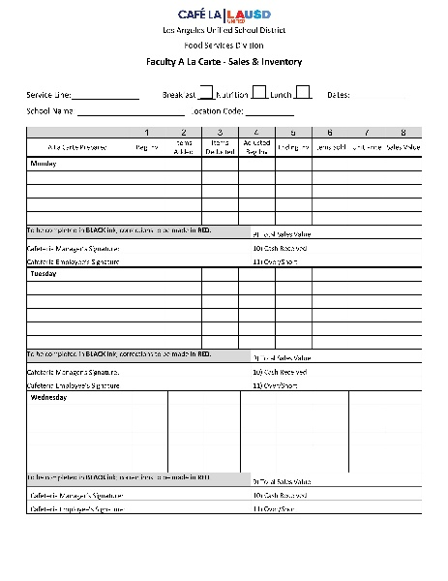
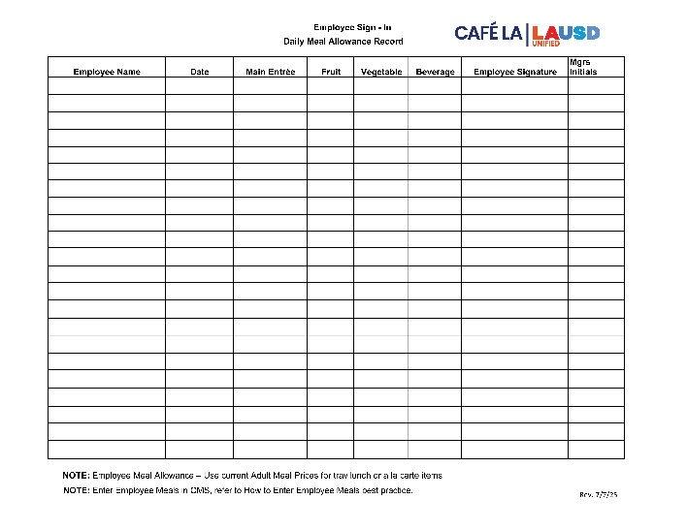
Accounting for Employee Meals
All food service employees are to complete the
Daily Meal Allowance Record Form to record their meals.
    Allowance is one daily meal, either a student tray lunch or breakfast, including one beverage
    All food items must be recorded on column 8 of the Production Record and on the Faculty A La Carte Sales and Inventory Form

Slide 41
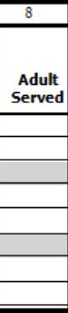
How to Record Adult Meals
Adult meals consist of meals consumed by:
Food service employees
All other adults, other LAUSD employees, parents, or visitors on campus.
All adult meals are recorded in Column 8.
To differentiate between meals served to
adults and employees, draw a line down
Column 8
Label “E” for employee, “A” for adult
E
A
This will help when completing the Meals Revenue tab.

Slide 42

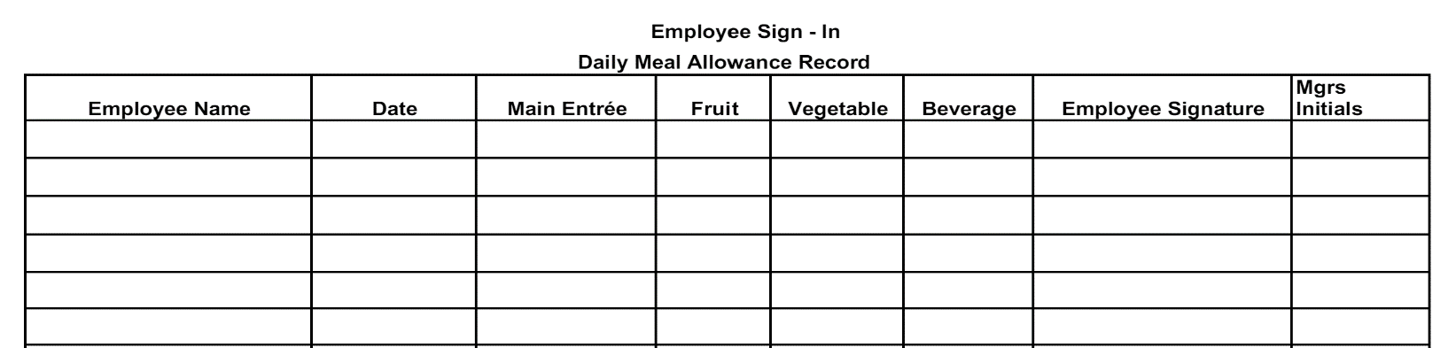









Document employee meals using the Daily Meal Allowance Record.
Document the employee meals in Column 8.
1 Burger
2 Caesar Salads
2 Apples
1 Orange
1 Baby Carrots
1 Potato Wedges
1 Choco Milk
1 (1%) Milk
All food service employees, permanent or substitute and the Food Services Manager are required to complete the “Daily Meal Allowance Record” when consuming food from the cafeteria.
Oswald Gomez V
8/19/2025
Beef Burger
Apple
Baby Carrots
Choco Milk
Oswald Gomez V
O.G.
Kiki Johnson
8/19/2025
Caesar Salad
Apple
1% milk
Kiki Johnson
O.G.
Maria Md
8/19/2025
Caesar Salad
Orange
Wedges
Maria Md
O.G.

Slide 43
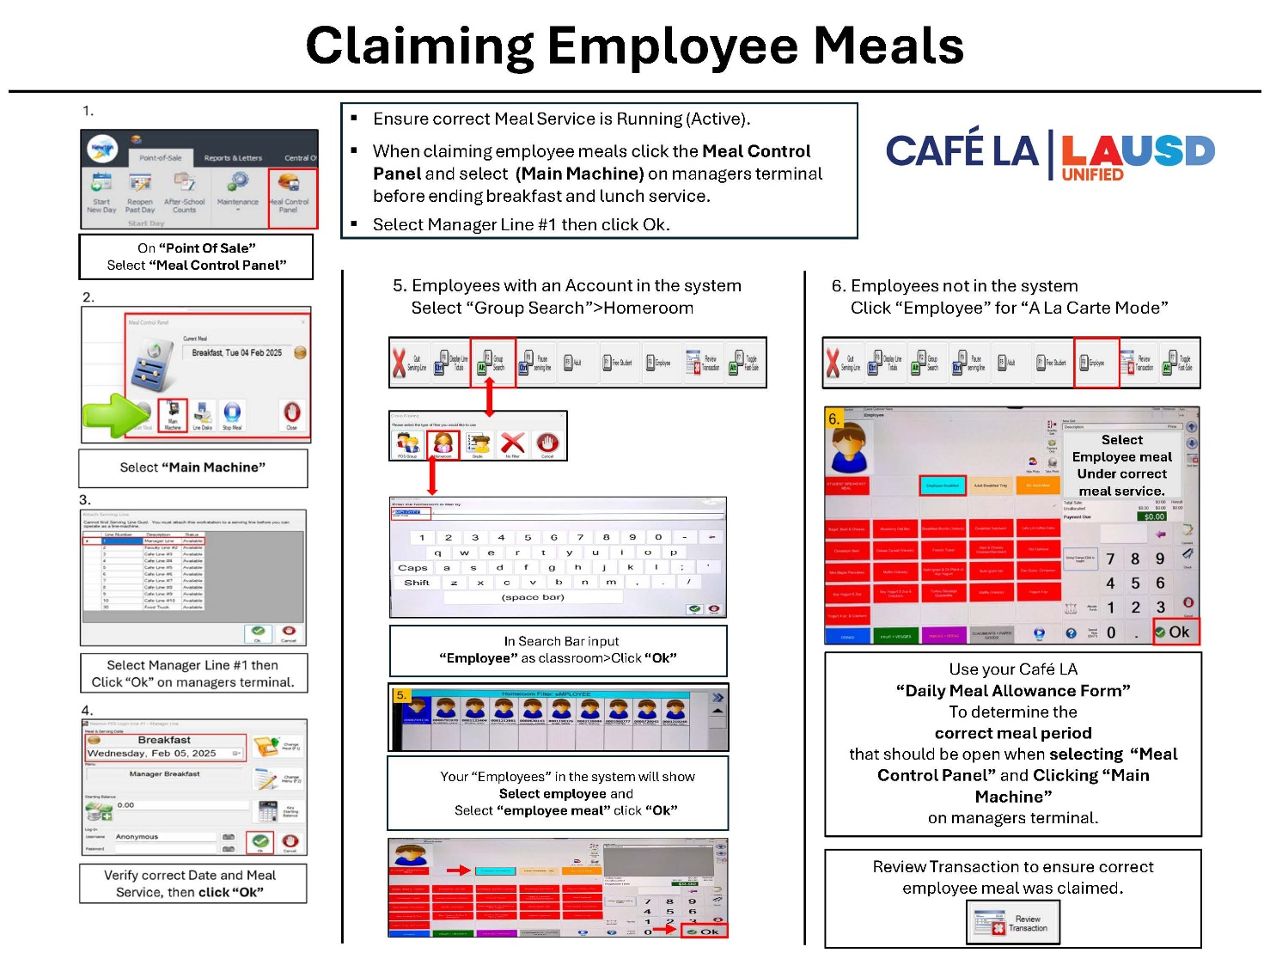
Claiming Employee Meals
Managers will input all employee meals using the managers terminal following their Daily Meal Allowance Form and Production Worksheet Column 8.
FSD Website > Heartland Resources

Slide 44
# 11111111 Los Angeles El
8/18/2025
Lunch
Service
Begins!!!
Comments:
Food Service Worker Signature:
Cafeteria Manager Signature:
Cafeteria Manager, by signing, is certifying that the information on the report is true, correct and in accordance with Food Services policies and procedures.
(c) 2005 Horizon Software International, LLC. All rights reserved.
Production Record Worksheet
Page 1 of 1

Slide 45
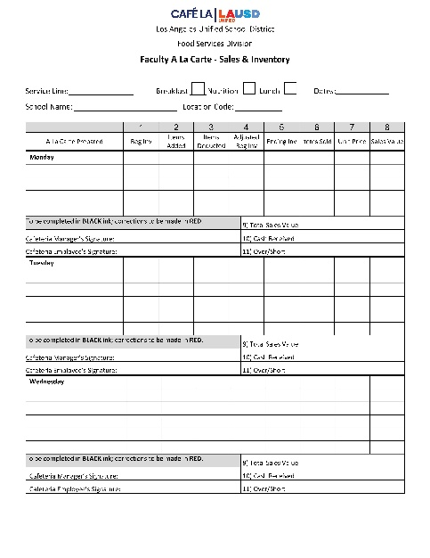
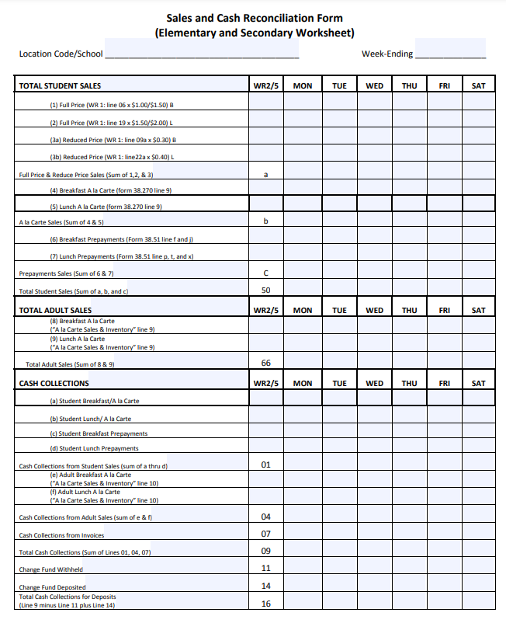
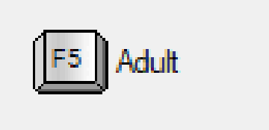
Accounting for Adult Meals
Adult meals can be sold as a la carte or by tray
Charge meals under “Adult” on the POS
  If the adult has an account in MCS, payments can be made through MySchoolBucks
  Record all adult purchases on the Faculty A La Carte Sales and Inventory Form
  Use the Sales and Cash Reconciliation Form to record adult sales for the week
Adult

Slide 46




















Faculty
Enjoy your meal
Ms. Parker!
Hey, may I please purchase a Caesar Salad, apple, potato wedges, and a chocolate milk.
1 Adult Tray Sold

Slide 47



Use the Faculty A La Carte Form to keep track of faculty sales during each service.
8/18/25-8/22/25

Slide 48


Sure thing
Mr. Clean, enjoy your orange.
Faculty
Hi, can I buy an orange?
1 Orange Sold A La Carte

Slide 49

Use the Faculty A La Carte Form to keep track of faculty sales during each service.

Slide 50

















Elementary
Lunch Service

Slide 51
# 11111111 Los Angeles El
8/18/2025
Lunch
Service
Ends!!!
Comments:
Food Service Worker Signature:
Cafeteria Manager Signature:
Cafeteria Manager, by signing, is certifying that the information on the report is true, correct and in accordance with Food Services policies and procedures.
(c) 2005 Horizon Software International, LLC. All rights reserved.
Production Record Worksheet
Page 1 of 1

Slide 52





Document the employee meals from the Daily Meal Allowance Record onto the Production Worksheet in Column 8.
Document the adult sales from the Faculty A La Carte Form onto the Production Worksheet in Column 8.
1 Burger
2 Caesar Salads
2 Apples
1 Orange
1 Baby Carrots
1 Potato Wedge
1 Choco Milk
1 (1%) Milk
1 Caesar Salad
1 Potato Wedge
1 Apple
1 Choco Milk
A La Carte
1 Orange

Slide 53
Los Angeles El.
GARDENA HS
Production Worksheet
# 11111111 Los Angeles El
Schoool Name & Location #: 1866401 GARDENA HS |  |  |  |  | Meal Count
Date: 8/1/23 |  |  |  |  |  |  | Students |  |  |  |  |  |  |  |  |  |  |  | Adults |  | Total
Serving Period: Lunch |  |  |  |  |  |  | Required - Unless denoted with an Asterisk (*)
# of Reimbursable Meals: |  |  |  |  | Age/grade Groups |  | All |  | Other
Total Meals Served: |  |  |  |  | Estimated
Offer vs. Serve: Yes |  |  |  |  | Actual
1 | 2 |  | 3 | 4 | 5 | 6 |  |  |  | 7 |  | 8 | 9 | 10 |  | 11 |  | 12 |  | 13
Recipe Number | Food Item Description |  | Total Projected Servings | Portion Size | Portion Cost | INVENTORY USED |  |  |  | Amount Prepared |  | Adult Served | Non-Rei mbursa ble/ a la Carte | Student Meal Portions Available |  | Amount Leftover |  | Amount Used |  | Cost of Amount Used
 |  |  |  |  |  | Cases, Units, Servings |  | Broken
Unassigned Items
7123 |  | MILK WHITE NONFAT 1/2 PINT | 60 | 1-Each 1/2 PT
2589 |  | PIZZA BEEF-TURKEY PEPPERONI IW | 50 | 1-Each Wedge
R4344 |  | Caesar Salad (1 C) | 50 | 1-1 Serving
3800 |  | APPLES FRESH RED/GREEN 125 CT | 350 | 1-Each Whole Appl
3006 |  | CARROTS BABY FRESH (1/2 C) | 150 | 1-Each Bag (2.5 oz
1308 |  | ORANGE MEDLEY JUICE CS/40 | 200 | 1-Each 4.23 fl oz.
3908 |  | ORANGES, FRESH CS/60 CT | 300 | 1-Each Whole
Entree Items
R0703 |  | Deli Turkey & Cheese Sandwich | 100 | 1-1 Ea Sandwich
R0090 |  | Cafe LA Burger | 450 | 1-1 Serving
Milk Items
7014 |  | MILK CHOCO NON FAT 1/2PT | 250 | 1-Each (1/2 pint)
7100 |  | MILK 1 % LOW FAT 1/2 PT ECO | 60 | 1-Each (1/2 pint)
8/19/2025
E
A
60
50
1
50
2
350
2
1
150
1
1198
Roasted Potato Wedges
200
1
300
1
1
100
450
1
250
1
1
60
1
Using the Daily Meal Allowance Record
Column 8 is filled out, when employees eat a meal.
Comments:
Cafeteria Manager Signature:
Food Service Worker Signature:
Cafeteria Manager, by signing, is certifying that the information on the report is true, correct and in accordance with Food Services policies and procedures.
(c) 2005 Horizon Software International, LLC. All rights reserved.
Production Record Worksheet
Page 1 of 1

Slide 54



Ohhhh! I see 5 empty trays, looks like some customers took double the
roasted potato wedges.
Let’s add those to
Column 9.
5 Non-Reimbursable potato wedges

Slide 55


Leftovers
Leftovers From Lunch
Now we count the leftovers from lunch and input the leftover amounts in
Column 11
2 -Pizza
5 -Apples
5 –Oranges
1 -LF 1% Milk
3 -Caesar Salad
3 –Café LA Burgers
5 -Baby Carrots
3 –Non-Fat Milk
3 -Chocolate Milk
3 -Deli Turkey Sandwich
2 –Roasted Potato Wedges

Slide 56
GARDENA HS
Production Worksheet
Los Angeles El.
# 11111111 Los Angeles El
Schoool Name & Location #: 1866401 GARDENA HS |  |  |  |  | Meal Count
Date: 8/1/23 |  |  |  |  |  |  | Students |  |  |  |  |  |  |  |  |  |  |  | Adults |  | Total
Serving Period: Lunch |  |  |  |  |  |  | Required - Unless denoted with an Asterisk (*)
# of Reimbursable Meals: |  |  |  |  | Age/grade Groups |  | All |  | Other
Total Meals Served: |  |  |  |  | Estimated
Offer vs. Serve: Yes |  |  |  |  | Actual
1 | 2 |  | 3 | 4 | 5 | 6 |  |  |  | 7 |  | 8 | 9 | 10 |  | 11 |  | 12 |  | 13
Recipe Number | Food Item Description |  | Total Projected Servings | Portion Size | Portion Cost | INVENTORY USED |  |  |  | Amount Prepared |  | Adult Served | Non-Rei mbursa ble/ a la Carte | Student Meal Portions Available |  | Amount Leftover |  | Amount Used |  | Cost of Amount Used
 |  |  |  |  |  | Cases, Units, Servings |  | Broken
Unassigned Items
7123 |  | MILK WHITE NONFAT 1/2 PINT | 60 | 1-Each 1/2 PT
2589 |  | PIZZA BEEF-TURKEY PEPPERONI IW | 50 | 1-Each Wedge
R4344 |  | Caesar Salad (1 C) | 50 | 1-1 Serving
3800 |  | APPLES FRESH RED/GREEN 125 CT | 350 | 1-Each Whole Appl
3006 |  | CARROTS BABY FRESH (1/2 C) | 150 | 1-Each Bag (2.5 oz
1308 |  | ORANGE MEDLEY JUICE CS/40 | 200 | 1-Each 4.23 fl oz.
3908 |  | ORANGES, FRESH CS/60 CT | 300 | 1-Each Whole
Entree Items
R0703 |  | Deli Turkey & Cheese Sandwich | 100 | 1-1 Ea Sandwich
R0090 |  | Cafe LA Burger | 450 | 1-1 Serving
Milk Items
7014 |  | MILK CHOCO NON FAT 1/2PT | 250 | 1-Each (1/2 pint)
7100 |  | MILK 1 % LOW FAT 1/2 PT ECO | 60 | 1-Each (1/2 pint)
8/19/2025
E
A
60
3
50
2
50
2
1
3
350
2
1
5
150
1
5
1198
Roasted Potato Wedges
200
1
5
2
300
1
1
5
100
3
450
1
3
250
1
1
3
60
1
1
1 Adult tray sold ( 1 Caesar Salad, 1 apple, 1 roasted potato wedge, and 1 chocolate milk).Entered in Column 8.
5 Potato wedges & 1 orange will be entered in Column 9.
Column 8: Input Number of Employees & Adult Customers who purchased or received a Full Meal.
Column 9: Input the number of A LA Carte Sales and items that are burned or non-reimbursable.
Comments:
Cafeteria Manager Signature:
Food Service Worker Signature:
Cafeteria Manager, by signing, is certifying that the information on the report is true, correct and in accordance with Food Services policies and procedures.
(c) 2005 Horizon Software International, LLC. All rights reserved.
Production Record Worksheet
Page 1 of 1

Slide 57
Los Angeles El.
GARDENA HS
Production Worksheet
# 11111111 Los Angeles El
Schoool Name & Location #: 1866401 GARDENA HS |  |  |  |  | Meal Count
Date: 8/1/23 |  |  |  |  |  |  | Students |  |  |  |  |  |  |  |  |  |  |  | Adults |  | Total
Serving Period: Lunch |  |  |  |  |  |  | Required - Unless denoted with an Asterisk (*)
# of Reimbursable Meals: |  |  |  |  | Age/grade Groups |  | All |  | Other
Total Meals Served: |  |  |  |  | Estimated
Offer vs. Serve: Yes |  |  |  |  | Actual
1 | 2 |  | 3 | 4 | 5 | 6 |  |  |  | 7 |  | 8 | 9 | 10 |  | 11 |  | 12 |  | 13
Recipe Number | Food Item Description |  | Total Projected Servings | Portion Size | Portion Cost | INVENTORY USED |  |  |  | Amount Prepared |  | Adult Served | Non-Rei mbursa ble/ a la Carte | Student Meal Portions Available |  | Amount Leftover |  | Amount Used |  | Cost of Amount Used
 |  |  |  |  |  | Cases, Units, Servings |  | Broken
Unassigned Items
7123 |  | MILK WHITE NONFAT 1/2 PINT | 60 | 1-Each 1/2 PT
2589 |  | PIZZA BEEF-TURKEY PEPPERONI IW | 50 | 1-Each Wedge
R4344 |  | Caesar Salad (1 C) | 50 | 1-1 Serving
3800 |  | APPLES FRESH RED/GREEN 125 CT | 350 | 1-Each Whole Appl
3006 |  | CARROTS BABY FRESH (1/2 C) | 150 | 1-Each Bag (2.5 oz
1308 |  | ORANGE MEDLEY JUICE CS/40 | 200 | 1-Each 4.23 fl oz.
3908 |  | ORANGES, FRESH CS/60 CT | 300 | 1-Each Whole
Entree Items
R0703 |  | Deli Turkey & Cheese Sandwich | 100 | 1-1 Ea Sandwich
R0090 |  | Cafe LA Burger | 450 | 1-1 Serving
Milk Items
7014 |  | MILK CHOCO NON FAT 1/2PT | 250 | 1-Each (1/2 pint)
7100 |  | MILK 1 % LOW FAT 1/2 PT ECO | 60 | 1-Each (1/2 pint)
8/19/2025
E
A
60
3
57
50
2
48
50
2
1
3
47
350
2
1
5
345
150
1
5
145
1198
Roasted Potato Wedges
200
1
5
2
198
300
1
1
5
295
100
3
97
450
1
3
447
250
1
1
3
247
60
1
1
59
Column 12: Amount Used is calculated by using simple subtraction math. CMS will automatically fill in when input into OneSource.
Comments:
Cafeteria Manager Signature:
Food Service Worker Signature:
Cafeteria Manager, by signing, is certifying that the information on the report is true, correct and in accordance with Food Services policies and procedures.
(c) 2005 Horizon Software International, LLC. All rights reserved.
Production Record Worksheet
Page 1 of 1

Slide 58
Los Angeles El.
GARDENA HS
Production Worksheet
# 11111111 Los Angeles El
Schoool Name & Location #: 1866401 GARDENA HS |  |  |  |  | Meal Count
Date: 8/1/23 |  |  |  |  |  |  | Students |  |  |  |  |  |  |  |  |  |  |  | Adults |  | Total
Serving Period: Lunch |  |  |  |  |  |  | Required - Unless denoted with an Asterisk (*)
# of Reimbursable Meals: |  |  |  |  | Age/grade Groups |  | All |  | Other
Total Meals Served: |  |  |  |  | Estimated
Offer vs. Serve: Yes |  |  |  |  | Actual
1 | 2 |  | 3 | 4 | 5 | 6 |  |  |  | 7 |  | 8 | 9 | 10 |  | 11 |  | 12 |  | 13
Recipe Number | Food Item Description |  | Total Projected Servings | Portion Size | Portion Cost | INVENTORY USED |  |  |  | Amount Prepared |  | Adult Served | Non-Rei mbursa ble/ a la Carte | Student Meal Portions Available |  | Amount Leftover |  | Amount Used |  | Cost of Amount Used
 |  |  |  |  |  | Cases, Units, Servings |  | Broken
Unassigned Items
7123 |  | MILK WHITE NONFAT 1/2 PINT | 60 | 1-Each 1/2 PT
2589 |  | PIZZA BEEF-TURKEY PEPPERONI IW | 50 | 1-Each Wedge
R4344 |  | Caesar Salad (1 C) | 50 | 1-1 Serving
3800 |  | APPLES FRESH RED/GREEN 125 CT | 350 | 1-Each Whole Appl
3006 |  | CARROTS BABY FRESH (1/2 C) | 150 | 1-Each Bag (2.5 oz
1308 |  | ORANGE MEDLEY JUICE CS/40 | 200 | 1-Each 4.23 fl oz.
3908 |  | ORANGES, FRESH CS/60 CT | 300 | 1-Each Whole
Entree Items
R0703 |  | Deli Turkey & Cheese Sandwich | 100 | 1-1 Ea Sandwich
R0090 |  | Cafe LA Burger | 450 | 1-1 Serving
Milk Items
7014 |  | MILK CHOCO NON FAT 1/2PT | 250 | 1-Each (1/2 pint)
7100 |  | MILK 1 % LOW FAT 1/2 PT ECO | 60 | 1-Each (1/2 pint)
8/19/2025
E
A
60
3
57
50
2
48
50
2
1
3
47
350
2
1
5
345
150
1
5
145
1198
Roasted Potato Wedges
200
1
5
2
198
300
1
1
5
295
100
3
97
450
1
3
447
250
1
1
3
247
60
1
1
59
Senior or staff will sign their first or last name with a pen and turn into manager for final review and submission.
Comments:
Gomez Adams
Cafeteria Manager Signature:
Food Service Worker Signature:
Cafeteria Manager, by signing, is certifying that the information on the report is true, correct and in accordance with Food Services policies and procedures.
(c) 2005 Horizon Software International, LLC. All rights reserved.
Production Record Worksheet
Page 1 of 1

Slide 59
# 11111111 Los Angeles El
8/18/2025
Manager will
Verify the
Meal Count
Report
Comments:
Amazing You
Food Service Worker Signature:
Cafeteria Manager Signature:
Cafeteria Manager, by signing, is certifying that the information on the report is true, correct and in accordance with Food Services policies and procedures.
(c) 2005 Horizon Software International, LLC. All rights reserved.
Production Record Worksheet
Page 1 of 1

Slide 60



Meal Count Report
Information from the Meal Counts Report is transferred to the “Meals/Revenue” tab, this includes:
  Reimbursable totals are entered into the “All” box
  Employee meals entered in the “Employees” box
  Adult meals entered in the “Adults” box
592
8/19/2025
6
1
3
592
3
1
596

Slide 61



Meal/Revenue Tab Details
There are five options available under the Meals/Revenue tab.
  All: Total number of reimbursable meals
  Others: A la carte, dropped, burnt, theft
  Adults: Total number of faculty meals
  Employees: Total number of food service staff meals
  Total Meals: Automatically calculated
  in CMS
1
3

Slide 62
Los Angeles El.
GARDENA HS
Production Worksheet
# 11111111 Los Angeles El
# 11111111 Los Angeles El
Schoool Name & Location #: 1866401 GARDENA HS |  |  |  |  | Meal Count
Date: 8/1/23 |  |  |  |  |  |  | Students |  |  |  |  |  |  |  |  |  |  |  | Adults |  | Total
Serving Period: Lunch |  |  |  |  |  |  | Required - Unless denoted with an Asterisk (*)
# of Reimbursable Meals: |  |  |  |  | Age/grade Groups |  | All |  | Other
Total Meals Served: |  |  |  |  | Estimated
Offer vs. Serve: Yes |  |  |  |  | Actual
1 | 2 |  | 3 | 4 | 5 | 6 |  |  |  | 7 |  | 8 | 9 | 10 |  | 11 |  | 12 |  | 13
Recipe Number | Food Item Description |  | Total Projected Servings | Portion Size | Portion Cost | INVENTORY USED |  |  |  | Amount Prepared |  | Adult Served | Non-Rei mbursa ble/ a la Carte | Student Meal Portions Available |  | Amount Leftover |  | Amount Used |  | Cost of Amount Used
 |  |  |  |  |  | Cases, Units, Servings |  | Broken
Unassigned Items
7123 |  | MILK WHITE NONFAT 1/2 PINT | 60 | 1-Each 1/2 PT
2589 |  | PIZZA BEEF-TURKEY PEPPERONI IW | 50 | 1-Each Wedge
R4344 |  | Caesar Salad (1 C) | 50 | 1-1 Serving
3800 |  | APPLES FRESH RED/GREEN 125 CT | 350 | 1-Each Whole Appl
3006 |  | CARROTS BABY FRESH (1/2 C) | 150 | 1-Each Bag (2.5 oz
1308 |  | ORANGE MEDLEY JUICE CS/40 | 200 | 1-Each 4.23 fl oz.
3908 |  | ORANGES, FRESH CS/60 CT | 300 | 1-Each Whole
Entree Items
R0703 |  | Deli Turkey & Cheese Sandwich | 100 | 1-1 Ea Sandwich
R0090 |  | Cafe LA Burger | 450 | 1-1 Serving
Milk Items
7014 |  | MILK CHOCO NON FAT 1/2PT | 250 | 1-Each (1/2 pint)
7100 |  | MILK 1 % LOW FAT 1/2 PT ECO | 60 | 1-Each (1/2 pint)
8/19/2025
E
A
60
3
57
50
2
48
50
2
1
3
47
350
2
1
5
345
150
1
5
145
1198
Roasted Potato Wedges
200
1
5
2
198
300
1
1
5
295
100
3
97
455
1
3
447
250
1
1
3
247
60
1
1
59
Manager will look at the Meal Count Report in the CMS system for number of meals served.
Comments:
Gomez Adams
Food Service Worker Signature:
Cafeteria Manager Signature:
Cafeteria Manager, by signing, is certifying that the information on the report is true, correct and in accordance with Food Services policies and procedures.
(c) 2005 Horizon Software International, LLC. All rights reserved.
Production Record Worksheet
Page 1 of 1

Slide 63



Los Angeles El.
Los Angeles Elementary
8/19/2025
# 11111111 Los Angeles El
8/18/2025
592
# 11111111 Los Angeles El
596
8/19/2025
3
596
2
3
596
Manager will look at the Meal Count Report in the CMS system for number of meals served.
A La Carte Forms
Daily Meal
Allowance
You must subtract the Adult & Employee meals from total meals.
(596 Total Meals) – (1 Adult Meal) – (3 Employee Meals)
= 592 reimbursable meals
Cafeteria Manager Signature:

Slide 64
PRODUCTION
RECORDS

Slide 65


What is a Production Record?
It’s a valuable tool for tracking and predicting future production quantities.
After each meal service, information from the Production Worksheet and the CMS Meal Counts Report is transferred into the CMS Production Record.
  The information entered supports the claim for State and Federal reimbursements.
Production counts are manually recorded.
Counts are transferred to CMS.
Production Record is completed in CMS.

Slide 66

Meals/ Revenue Tab
Information from the Meals/Revenue tab generates data in the Profit and Loss report.
1111111111
Los Angeles El.
8/19/2025
Lunch
592
6
1
3
596

Slide 67

Meals/Revenue Tab Other Field
Transfer the “Non-Reimbursable/A la Carte” amount from column 9 of the Production Worksheet, into the “Other” box this includes:
    Dropped
    Burnt
    Theft
Los Angeles El.
8/19/2023
# 11111111 Los Angeles El
596
592
5 + 1 = 6
1
3

Slide 68



Daily Comment/ Menu
Select the Daily Comment/Menu tab and enter the following information:
  Menu Week - obtained from the BOH menu.
  Menu Day – M=1, T=2, W=3, TH=4, F=5, S=6.
  Comments – document burnt, dropped, theft.
  Calendar - verify that the Calendar items match those listed on the Production Record.
1111111
Los Angeles El.
8/19/2025
Lunch
August 18th-22nd,2025
8/18/25
8/19/25
8/20/25
8/21/25
8/22/25

Slide 69
Production Worksheet Data to
CMS Production Record
After signing and verifying the information on the Production Worksheet, the food service manager will input the worksheet data into the CMS Production Record.
Item Counts
Pull Tickets
Meals / Revenue
Temperature
Daily Comment / Menu
Stock
Number
Stock
Descriptions
From
Leftovers
Rec-
ipe
Portion Size
Proj-
ected
Exce-
ption
Total
Prepared
Added
Left-
over
Served
Non
Reimb.
Adult
Leftover
Code
R1056N
Breakfast Burrito (premade)
1-1 Each (3.95 oz)
130
0
0
0
0
0
0
0
Return to
3204
Bananas (100-120 CT)
1-Each Banana
120
0
0
0
0
0
0
0
Return to
7010
Milk 1% Low Fat ½ PT EC
1-Each (1/2pint)
130
0
0
0
0
0
0
0
Return to
Note: Never enter any information into the Served column, CMS automatically calculates the quantities.
Disposition Comment:
Add Item
Remove Item
Substitute Item
Item Details
Adjust Exception
View Exception

Slide 70

Add Item to Production Record
To ADD an item to the Production Record:
“Select” the “Add Item” box.
Select the menu item and enter the items information in the “Description” box.
  Click the "Search" button and wait for the search results to appear.

Slide 71

Add Item to Production
Verify that “Each” is selected in the “Measure” box; this will avoid adding by the case.
Finish the process by clicking “Add Items And Return to Production.”
Quantity Serving Size is always 1.
Measure will always be ( 1-EACH, 1-8oz)
Never Should say CASE

Slide 72


Leftover Codes
All leftovers require a Leftover Code selection and Disposition Comment.
Use the dropdown arrow to select the leftover code.
Serve Next Day
Dispose Of
Return to Stock
The leftover codes: Freeze, Refrigerate, and Served As Seconds are NOT utilized.

Slide 73

Removing An Item
Items listed on the Production Record not used for service
must be removed from the “Daily Production "section.
Examples of removed items:
Items coded as “Serve Next Day” but are not suitable for service
Substituted menu items
Delivery shortages

Slide 74

Complete CMS Production Record
The final steps to completing the process include:
  Check “Update Inventory” box
  Check “Complete Production” box
  Click “Save” button at the top of the screen

Slide 75
Los Angeles El.
GARDENA HS
Production Worksheet
# 11111111 Los Angeles El
# 11111111 Los Angeles El
Schoool Name & Location #: 1866401 GARDENA HS |  |  |  |  | Meal Count
Date: 8/1/23 |  |  |  |  |  |  | Students |  |  |  |  |  |  |  |  |  |  |  | Adults |  | Total
Serving Period: Lunch |  |  |  |  |  |  | Required - Unless denoted with an Asterisk (*)
# of Reimbursable Meals: |  |  |  |  | Age/grade Groups |  | All |  | Other
Total Meals Served: |  |  |  |  | Estimated
Offer vs. Serve: Yes |  |  |  |  | Actual
1 | 2 |  | 3 | 4 | 5 | 6 |  |  |  | 7 |  | 8 | 9 | 10 |  | 11 |  | 12 |  | 13
Recipe Number | Food Item Description |  | Total Projected Servings | Portion Size | Portion Cost | INVENTORY USED |  |  |  | Amount Prepared |  | Adult Served | Non-Rei mbursa ble/ a la Carte | Student Meal Portions Available |  | Amount Leftover |  | Amount Used |  | Cost of Amount Used
 |  |  |  |  |  | Cases, Units, Servings |  | Broken
Unassigned Items
7123 |  | MILK WHITE NONFAT 1/2 PINT | 60 | 1-Each 1/2 PT
2589 |  | PIZZA BEEF-TURKEY PEPPERONI IW | 50 | 1-Each Wedge
R4344 |  | Caesar Salad (1 C) | 50 | 1-1 Serving
3800 |  | APPLES FRESH RED/GREEN 125 CT | 350 | 1-Each Whole Appl
3006 |  | CARROTS BABY FRESH (1/2 C) | 150 | 1-Each Bag (2.5 oz
1308 |  | ORANGE MEDLEY JUICE CS/40 | 200 | 1-Each 4.23 fl oz.
3908 |  | ORANGES, FRESH CS/60 CT | 300 | 1-Each Whole
Entree Items
R0703 |  | Deli Turkey & Cheese Sandwich | 100 | 1-1 Ea Sandwich
R0090 |  | Cafe LA Burger | 450 | 1-1 Serving
Milk Items
7014 |  | MILK CHOCO NON FAT 1/2PT | 250 | 1-Each (1/2 pint)
7100 |  | MILK 1 % LOW FAT 1/2 PT ECO | 60 | 1-Each (1/2 pint)
8/19/2025
592
596
E
A
60
3
57
50
2
48
50
2
1
3
47
350
1
5
345
150
1
5
145
1198
Roasted Potato Wedges
200
1
5
2
198
300
1
1
5
295
100
3
97
455
1
3
447
250
1
1
3
247
60
1
1
59
Comments:
Managers must write down comments reflecting what occurred during lunch service.
3 Employees ate a lunch meal (2-Caesar salads, 1-burger, 1-potato wedges, 1-apple, 1-orange,
1-Chocolate milk, and 1-1% milk.)
1 Adult Tray Sold ( 1-Caesar Salad, 1-Apple, 1-Roasted Potato Wedge, 1-Chocolate milk)
1 Orange Sold A La Carte
5 Non-reimbursable Roasted Potato Wedges Due To Theft
Food Service Worker Signature:
Gomez Adams
Cafeteria Manager Signature:
Cafeteria Manager, by signing, is certifying that the information on the report is true, correct and in accordance with Food Services policies and procedures.
(c) 2005 Horizon Software International, LLC. All rights reserved.
Production Record Worksheet
Page 1 of 1

Slide 76


Production Worksheet Signature
When the Production Worksheet is complete, it is signed by:
  Food Service Worker/Senior Worker/Designee
  Food Service Manager
Los Angeles El
Los Angeles El
By signing the Production Worksheet, the FSM is certifying that the information on the report is true, correct and in accordance with Food Services Policies and Procedures.
F. Garcia
Anthony Gomez III.

Slide 77
Los Angeles El.
GARDENA HS
Production Worksheet
# 11111111 Los Angeles El
# 11111111 Los Angeles El
Schoool Name & Location #: 1866401 GARDENA HS |  |  |  |  | Meal Count
Date: 8/1/23 |  |  |  |  |  |  | Students |  |  |  |  |  |  |  |  |  |  |  | Adults |  | Total
Serving Period: Lunch |  |  |  |  |  |  | Required - Unless denoted with an Asterisk (*)
# of Reimbursable Meals: |  |  |  |  | Age/grade Groups |  | All |  | Other
Total Meals Served: |  |  |  |  | Estimated
Offer vs. Serve: Yes |  |  |  |  | Actual
1 | 2 |  | 3 | 4 | 5 | 6 |  |  |  | 7 |  | 8 | 9 | 10 |  | 11 |  | 12 |  | 13
Recipe Number | Food Item Description |  | Total Projected Servings | Portion Size | Portion Cost | INVENTORY USED |  |  |  | Amount Prepared |  | Adult Served | Non-Rei mbursa ble/ a la Carte | Student Meal Portions Available |  | Amount Leftover |  | Amount Used |  | Cost of Amount Used
 |  |  |  |  |  | Cases, Units, Servings |  | Broken
Unassigned Items
7123 |  | MILK WHITE NONFAT 1/2 PINT | 60 | 1-Each 1/2 PT
2589 |  | PIZZA BEEF-TURKEY PEPPERONI IW | 50 | 1-Each Wedge
R4344 |  | Caesar Salad (1 C) | 50 | 1-1 Serving
3800 |  | APPLES FRESH RED/GREEN 125 CT | 350 | 1-Each Whole Appl
3006 |  | CARROTS BABY FRESH (1/2 C) | 150 | 1-Each Bag (2.5 oz
1308 |  | ORANGE MEDLEY JUICE CS/40 | 200 | 1-Each 4.23 fl oz.
3908 |  | ORANGES, FRESH CS/60 CT | 300 | 1-Each Whole
Entree Items
R0703 |  | Deli Turkey & Cheese Sandwich | 100 | 1-1 Ea Sandwich
R0090 |  | Cafe LA Burger | 450 | 1-1 Serving
Milk Items
7014 |  | MILK CHOCO NON FAT 1/2PT | 250 | 1-Each (1/2 pint)
7100 |  | MILK 1 % LOW FAT 1/2 PT ECO | 60 | 1-Each (1/2 pint)
8/19/2025
592
593
E
A
60
3
57
50
2
48
50
2
1
3
47
350
1
5
345
150
1
5
145
1198
Roasted Potato Wedges
200
1
5
2
198
300
1
1
5
295
100
3
97
455
1
3
447
250
1
1
3
247
60
1
1
59
Manager will then sign the production work sheet with a pen and file in Folder #1 following record and retention guidelines.
Comments:
Gomez Adams
You The Amazing Manager
Food Service Worker Signature:
Cafeteria Manager Signature:
Cafeteria Manager, by signing, is certifying that the information on the report is true, correct and in accordance with Food Services policies and procedures.
(c) 2005 Horizon Software International, LLC. All rights reserved.
Production Record Worksheet
Page 1 of 1

Slide 78

Production Record Report
Review the Production Record for accuracy.
Los Angeles El
8/19/2025
Los Angeles El.

Slide 79
EEC AND OFF-SITES
PRODUCTION RECORDS

Slide 80



EEC & Off-Sites Meal Counts
The EEC & Off Sites Production Record will be projected as part of the EZ-Steps process.
EECs will complete Production Worksheets using the EEC drop-down site in CMS
Complete the Production Worksheet using the meal record
Los Angeles EEC
8/18/25
8/18/25
Los Angeles EEC

Slide 81
TROUBLESHOOTING

Slide 82
Common Production Errors
After entering information into the CMS Production Record, review for common input errors.
  No information entered – still shows as “0.”
  Numbers entered incorrectly – “920” entered as “92.”
  Incorrect portion size – “case” instead of “each.”
  Excessive dollar amounts in Cost of Amount Used.

Slide 83

Tutorial Video
Try troubleshooting before submitting a Remedy Ticket. If you can't find Production Records for this week, explain the issue in the Description section.

Slide 84






Remedy Ticket Best Practice
Instructions on how to create a remedy ticket are available on the Food Service website.
Training & Resource > CMS Section > “How to Create a Remedy Ticket.”

Slide 85
Recap
Who's responsible for entering information into the Production Worksheet?
All cafeteria staff is responsible for completing Production Worksheets.
Why is it crucial to ensure that the Production Worksheets and Production Records are accurate and complete daily?
The entered information supports the claim for reimbursements from the state and federal government.
What is a Production Record?
Production Records help plan menus, predict quantities, minimize waste, choose suitable options, and analyze nutrients.

Slide 86
Thank You

